Slide 1

Heart disease classification model

Slide 2
Introduction
You have just been hired as a Data Scientist at a Hospital with an alarming number of patients coming in reporting various cardiac symptoms. A cardiologist measures vitals & hands you this data to perform Data Analysis and predict whether certain patients have heart disease. We would like to make a Machine Learning algorithm where we can train our AI to learn & improve from experience. Thus, we would want to classify patients as either positive or negative for heart disease. We have a data which classified if patients have heart disease or not according to features in it. We will try to use this data to create a model which tries predicting if a patient has this disease or not. We will use logistic regression (classification) algorithm.

Slide 3
Data Description
age - age in years
sex - (1 = male; 0 = female)
cp - chest pain type
trestbps - resting blood pressure (in mm Hg on admission to the hospital)
chol - serum cholesterol in mg/dl
fbs - (fasting blood sugar > 120 mg/dl) (1 = true; 0 = false)
restecg - resting electrocardiographic results.
thalach - maximum heart rate achieved
exang - exercise induced angina (1 = yes; 0 = no)
oldpeak - ST depression induced by exercise relative to rest
slope - the slope of the peak exercise ST segment
ca - number of major vessels (0-3) colored by flourosopy
thal - 3 = normal; 6 = fixed defect; 7 = reversable defect
target - have disease or not (1=yes, 0=no)

Slide 4
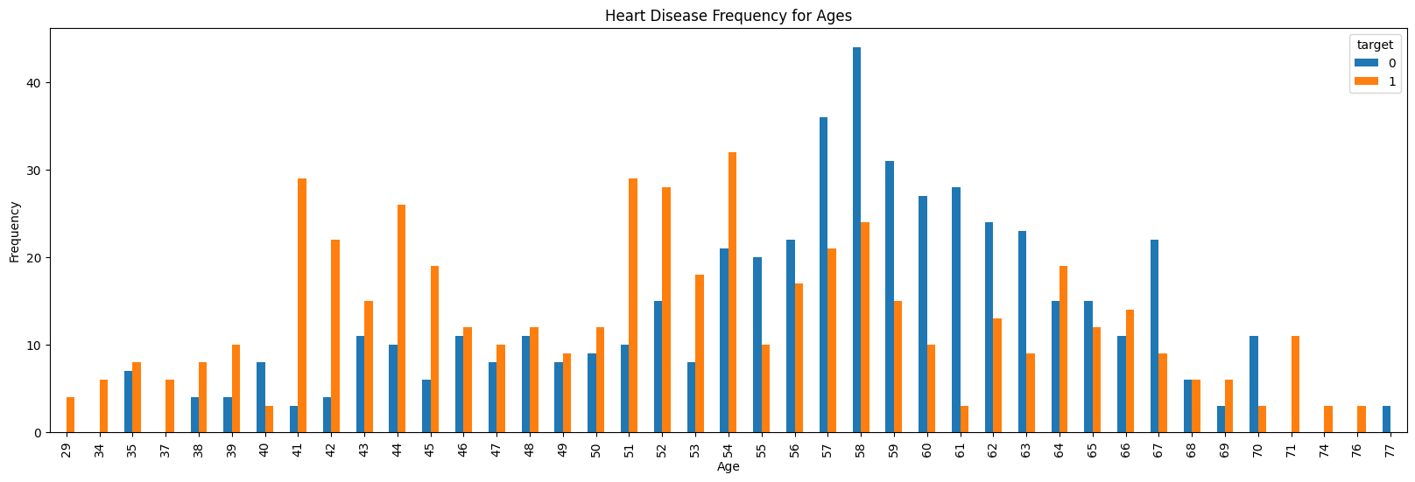
Heart Disease frequency of ages

Slide 5
Algorithms Logistic Regression K-Nearest Neighbour (KNN) Classification Support Vector Machine (SVM) Algorithm Naive Bayes Algorithm Decision Tree Algorithm Random Forest Classification

Slide 6
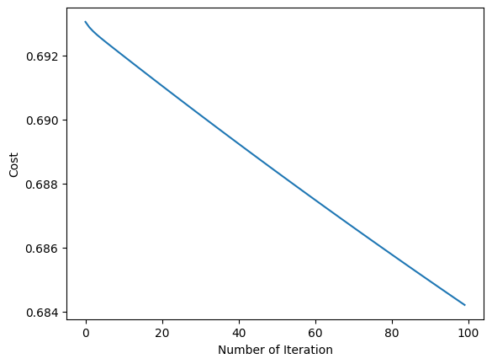
Logistic Regression
Logistic regression estimates the probability of an event occurring, such as voted or didn't vote, based on a given dataset of independent variables.
Manuel Test Accuracy: 63.41%

Slide 7
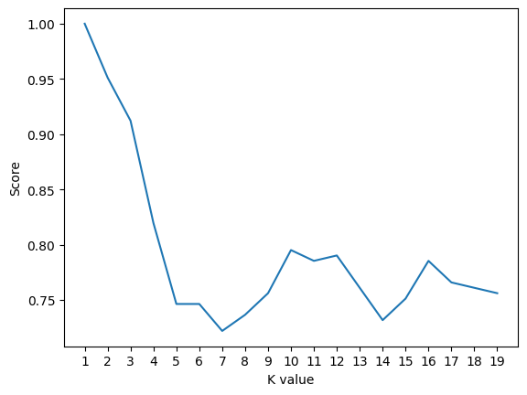
K-Nearest Neighbour (KNN) Classification
K-Nearest Neighbour is one of the simplest Machine Learning algorithms based on Supervised Learning technique. KNN algorithm assumes the similarity between the new case/data and available cases and put the new case into the category that is most similar to the available categories-KNN algorithm stores all the available data and classifies a new data point based on the similarity.
Maximum KNN Score is 100.00%.

Slide 8
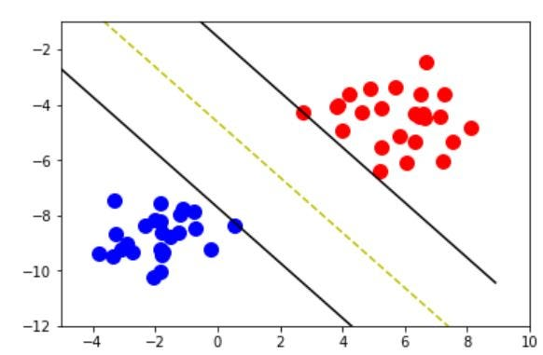
Support Vector Machine (SVM) Algorithm
Support Vector Machine (SVM) is a powerful machine learning algorithm used for linear or nonlinear classification, regression, and even outlier detection tasks. SVMs can be used for a variety of tasks, such as text classification, image classification, spam detection, handwriting identification, gene expression analysis, face detection, and anomaly detection.
By using SVM algorithm test accuracy will be 74.63%.

Slide 9
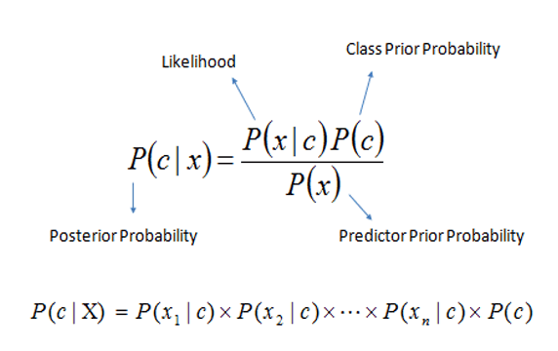
Naive Bayes Algorithm
Naive Bayes algorithm is a supervised learning algorithm, which is based on Bayes theorem and used for solving classification problems. It is mainly used in text classification that includes a high-dimensional training dataset. Naive Bayes Classifier is one of the simple and most effective Classification algorithms which helps in building the fast machine learning models that can make quick predictions.
By using Naive bayes algorithm accuracy will be 88.29%.

Slide 10

Decision Tree Algorithm
Decision Tree is a Supervised learning technique that can be used for both classification and Regression problems, but mostly it is preferred for solving Classification problems. It is a tree-structured classifier, where internal nodes represent the features of a dataset, branches represent the decision rules, and each leaf node represents the outcome. In a Decision tree, there are two nodes, which are the Decision Node and Leaf Node. The decisions or the test are performed based on features of the given dataset.
By using decision tree algorithm accuracy will be 100%.

Slide 11

Random Forest Classification
Random Forest is a popular machine learning algorithm that belongs to the supervised learning technique. It can be used for both Classification and Regression problems in MLAs the name suggests, "Random Forest is a classifier that contains a number of decision trees on various subsets of the given dataset and takes the average to improve the predictive accuracy of that dataset." Instead of relying on one decision tree, the random forest takes the prediction from each tree and based on the majority votes of predictions, and it predicts the final output.
By using Random Forest classification accuracy will be 100%

Slide 12
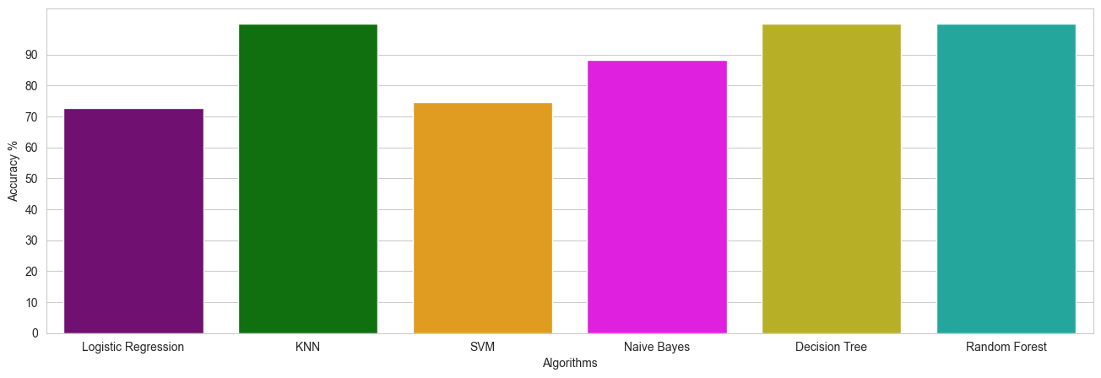
Comparing all algorithms

Slide 13
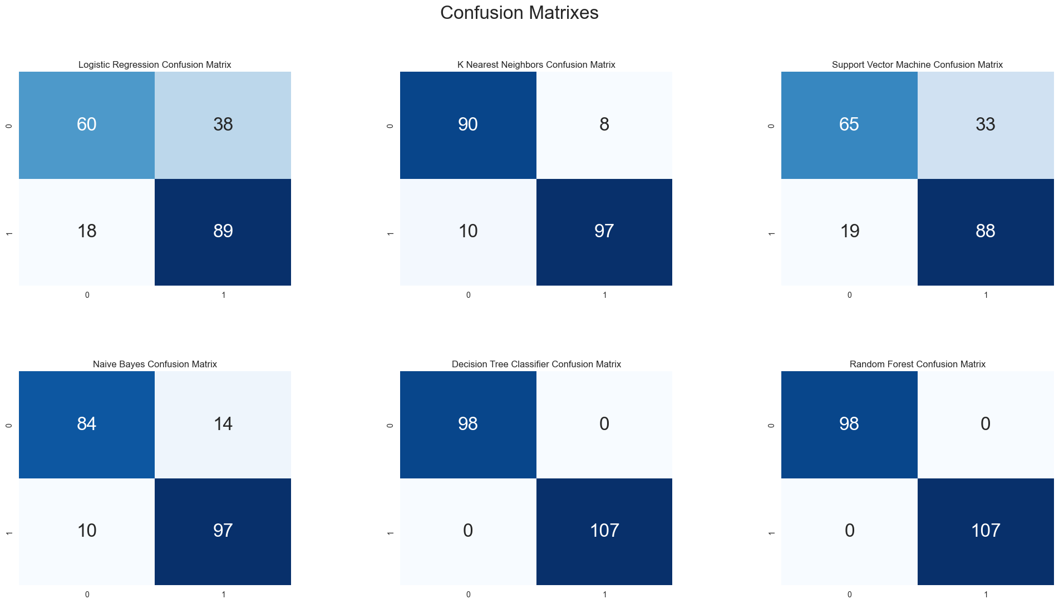
Confusion Matrix

Slide 14
Conclusion
Out of the 13 features we examined, the top 4 significant features that helped us classify between a positive & negative Diagnosis were chest pain type (cp), maximum heart rate achieved (thalach), number of major vessels (ca), and ST depression induced by exercise relative to rest (old peak). Our machine learning algorithm can now classify patients with heart disease. Now we can properly diagnose patients & get them the help they need to recover. By diagnosing detecting these features early, we may prevent worse symptoms from arising later. Our K-Nearest Neighbour (KNN) Classification yields the highest accuracy, 100%. Any accuracy above 70% is considered good but be careful because if your accuracy is extremely high, it may be too good to be true.

Slide 15
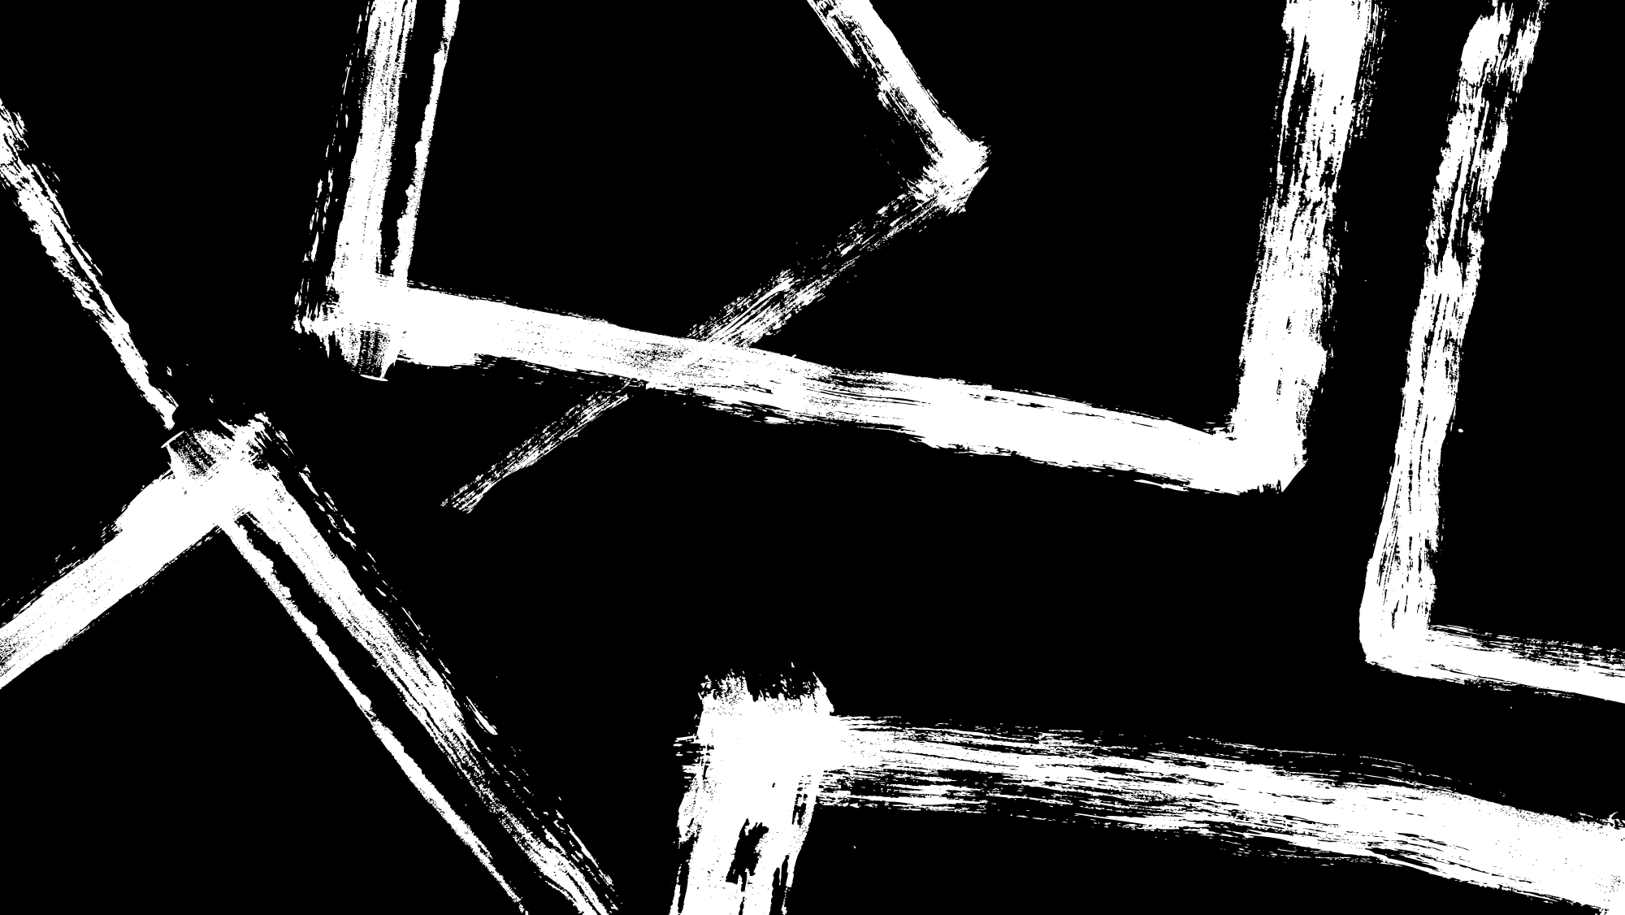
Thank You
Team Members
Rahul Boggavarapu
Vineeth Kolli
Sai Sri Teja Inuganti
Manish Reddy
Sathwik Kumar Rudroju
Vamsi Thorlikonda

